Slide 1
Project Presentation On “Flight Price Prediction” Presented By: Ajit Madame

Slide 2
Agenda
Problem Statement
Problem Understanding
Exploratory Data Analysis
Feature Selection
Model Building
Interpretation of the Results
Hyperparameter Tuning
The Model Saving And Testing
Key Finding and Conclusions
Limitation of this works and Scope for Future Works

Slide 3
Problem Statements Anyone who has booked a flight ticket knows how unexpectedly the prices vary. The cheapest available ticket on a given flight gets more and less expensive over time. This usually happens as an attempt to maximize revenue based on – Time of purchase patterns (making sure last-minute purchases are expensive) 2. Keeping the flight as full as they want it (raising prices on a flight which is filling up in order to reduce sales and hold back inventory for those expensive last-minute expensive purchases) Therefore, a predictive model to accurately predict Air fares is required to be made.

Slide 4
Problem Understanding Predictive modelling, Regression algorithms are some of the machine learning techniques used for predicting Flight Ticket prices. Identifying various relevant attributes like Airline Brand, flight duration, source and destination etc are crucial for working on the project as they determine the valuation of air fare.

Slide 5
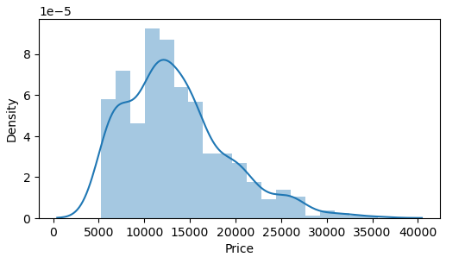
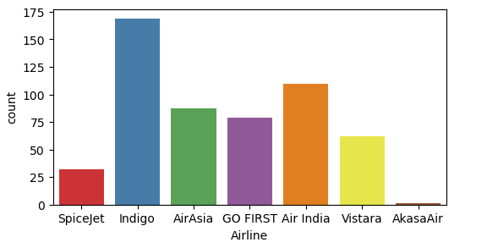
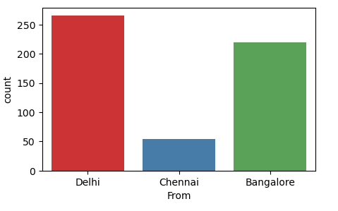
Exploratory Data Analysis Univariate Analysis Observation:- - Distribution is skewed and tails of from 15000 mark. - IndiGo has the highest number of flights followed by Air India and Air Asia. - Highest number of flights are from Delhi followed by Bangalore.

Slide 6
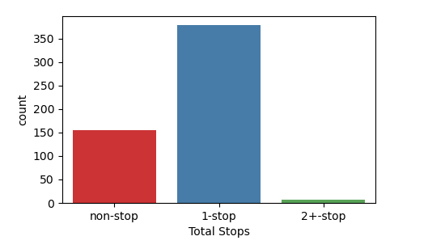
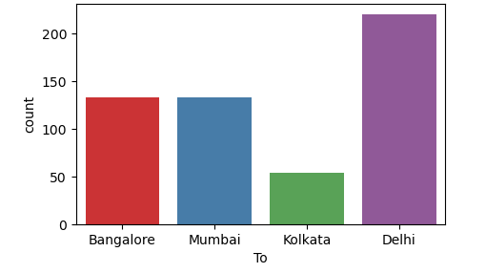
Observation: - Delhi is the most popular destination followed by Mumbai, Bangalore. - Highest number of flights have only 1 stop between source and destination while 2nd highest number of flights are non stop.

Slide 7
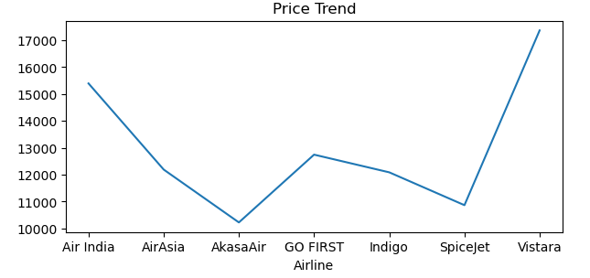
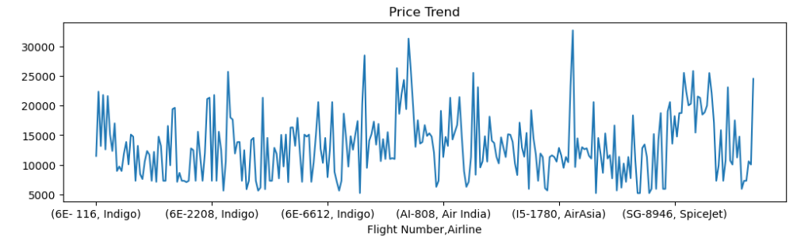
Bivariate Analysis: Observation: IndiGo and SpiceJet offer air tickets at the most affordable prices on average, whereas Air Asia, Air India are the most expensive on average.

Slide 8
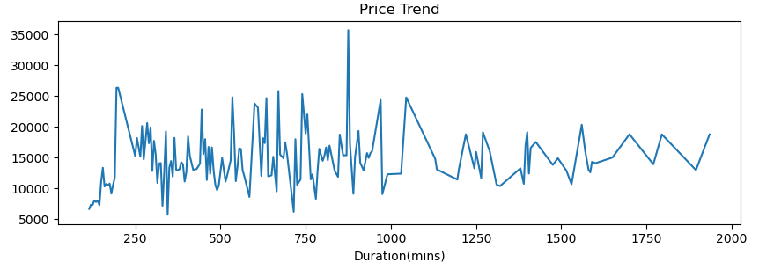
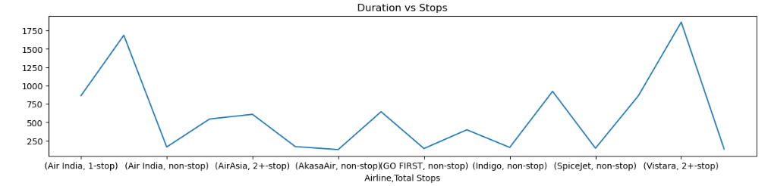
Observation: - we can see, mostly duration of flight is maximum lies in between 250 to 750 and they have 15000 to 25000 prices of ticket. - It can be observed that Number of Stops impact the travel time of Airlines.

Slide 9
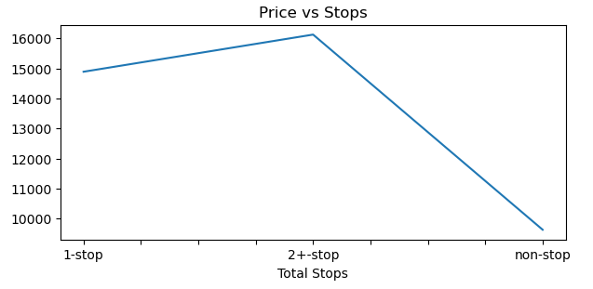
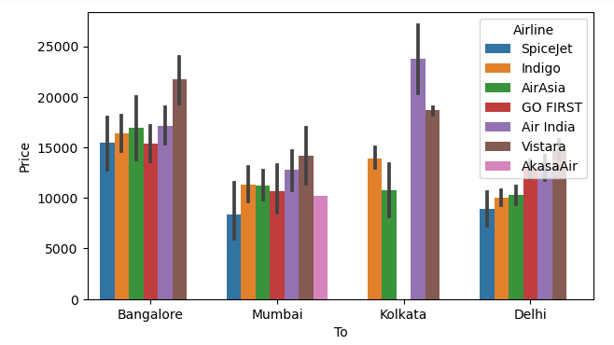
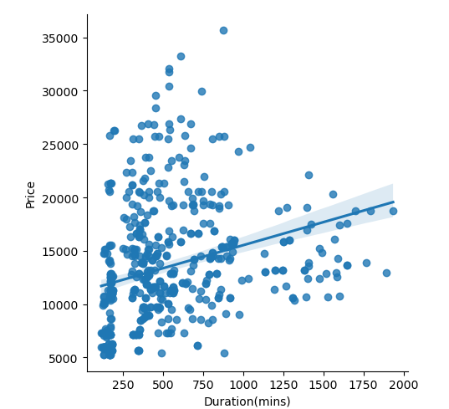
Observation:- - It can be observed that Number of Stops impact the Air Ticket Pricing of Airlines. - There is a linear relationship between Price and flight duration. - Bangalore,Kolakata are the most expensive destinations while Mumbai and Delhi are the most affordable destination. SpiceJet and Indigo provide most affordable Airtickets to the destinations.

Slide 10
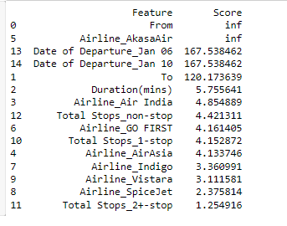
Features Selections Using SelectKBest and f_classif for measuring the respective ANOVA f-score values of the columns, the best features were selected. Using StandardScaler, the features were scaled by resizing the distribution values so that mean of the observed values in each feature column is 0 and standard deviation is 1. From sklearn.model_selection’s train_test_split, the data was divided into train and test data. Training data comprised 75% of total data where as test data comprised 25% based on the best random state that would result in best model accuracy.

Slide 11
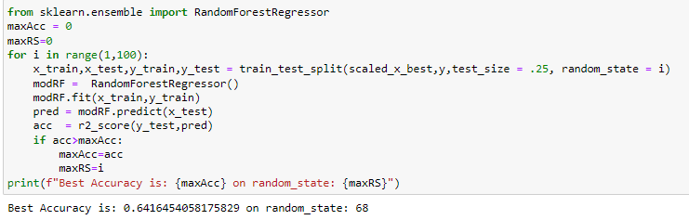
Models Building Finding Best Random State

Slide 12
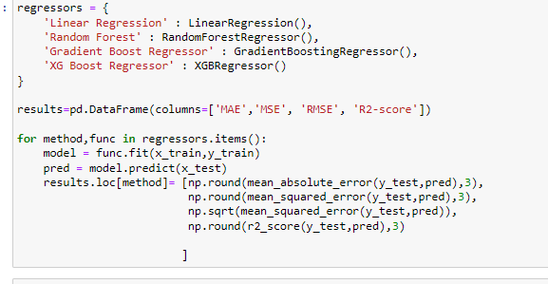
Trained the Models

Slide 13
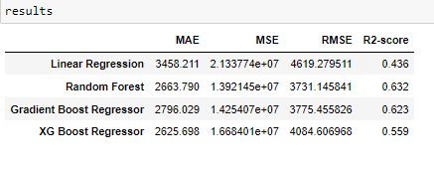
Analyzing Accuracy of The Models Mean Squared Error and Root Mean Squared Error metrics were used to evaluate the Model performance. The advantage of MSE and RMSE being that it is easier to compute the gradient. As, we take square of the error, the effect of larger errors become more pronounced than smaller error, hence the model can now focus more on the larger errors.

Slide 14
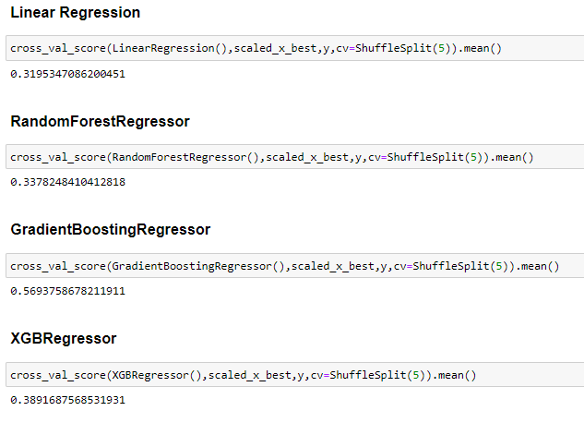
Cross Validation:- Cross validation is a technique for assessing how the statistical analysis generalizes to an independent data set. It is a technique for evaluating machine learning models by training several models on subsets of the available input data and evaluating them on the complementary subset of the data. Using cross-validation, there are high chances that we can detect over-fitting with ease. Model Cross Validation scores were then obtained for assessing how the statistical analysis generalizes to an independent data set. The models were evaluated by training several models on subsets of the available input data and evaluating them on the complementary subset of the data.

Slide 15
Interpretation of Result Based on comparing Accuracy Score results with Cross Validation results, it is determined that Gradient Boosting Regressor is the best model.

Slide 16
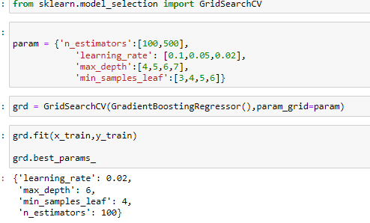
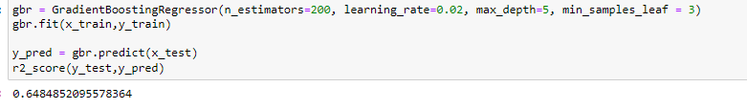
Hyperparameter Tuning

Slide 17
Key Finding and Conclusions
Air Fare attributes like Date,Month,Duration,Total Stops etc play a big role in influencing the used Flight price.
Airline Brand also has a very important role in determining the used Flight Ticket price. Various plots like Barplots,Countplots and Lineplots helped in visualising the Feature-label relationships which corroborated the importance of Air Fare features and attributes for estimating Flight Ticket Prices.
Due to the Training dataset being very small, only very small amount of the outliers was removed to ensure proper training of the models.
Therefore, Random Forest Regressor, which uses averaging to improve the predictive accuracy and controls over-fitting. performed well despite having to work on small dataset and produced good predictions that can be understood easily.

Slide 18
Limitation of this work and scope for future A small dataset to work with posed a challenge in building highly accurate models. This project also relied heavily on historical data and was unable to account for various other factors that influence demand and ticket pricing like pandemic status affecting demand, government regulations on air travel, shifting in routes, weather conditions, etc. Most airline companies also do no publicly make available their ticket pricing strategies, which makes gathering price and air fare related data sets using web scraping the only means to build a dataset for building predicting models. Availability of more features and a larger dataset would help build better models.

Slide 19


